Slide 1

Weekly Progress
Team C

Slide 2
Previous Week
- Created a framework for the basic UI
- Server & Database setting
- Crawler setting

Slide 3
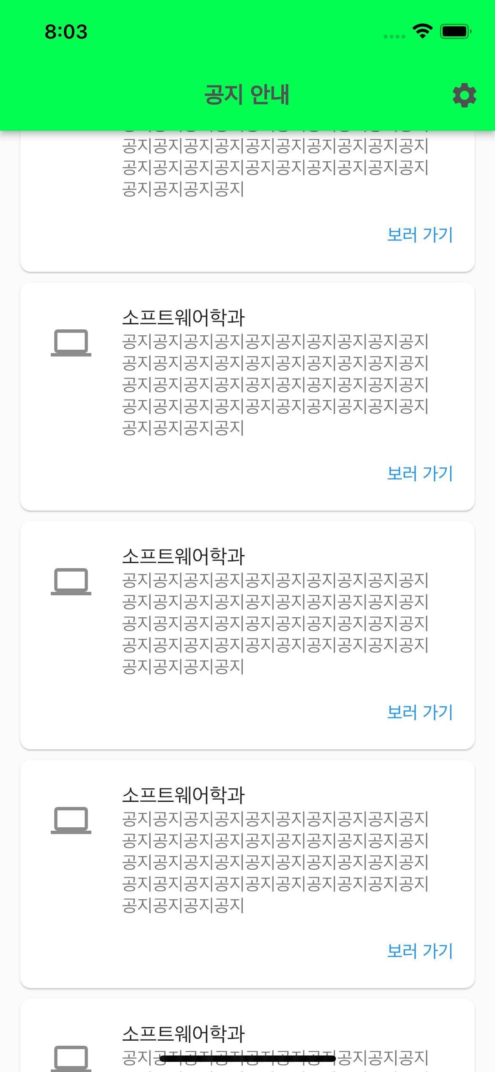
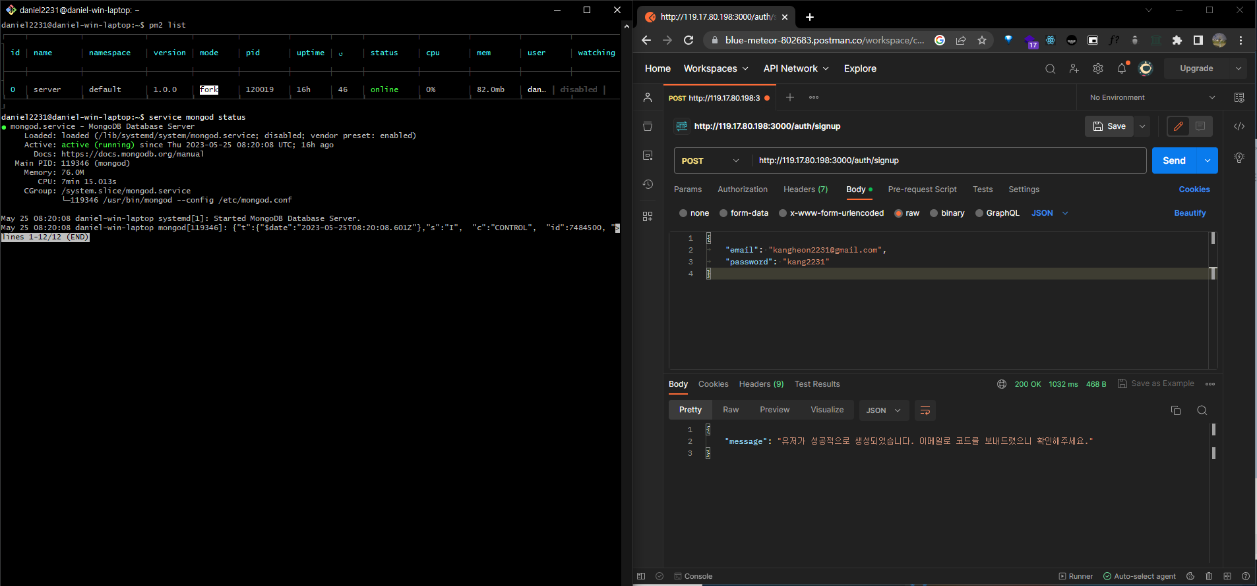
Basic UI / Server

Slide 4
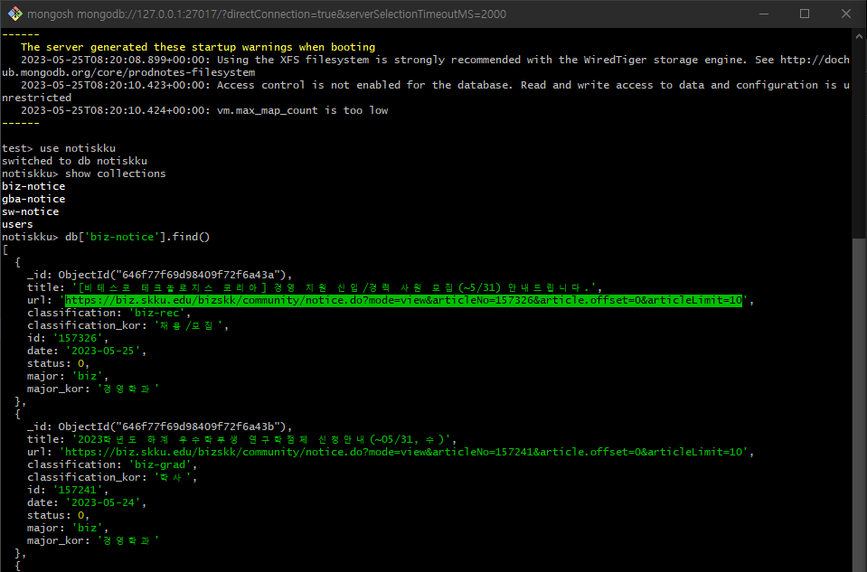
Crawler setting

Slide 5
This Week
- Link page to the server
- Sign Up, Sign In, Check Notice

Slide 6
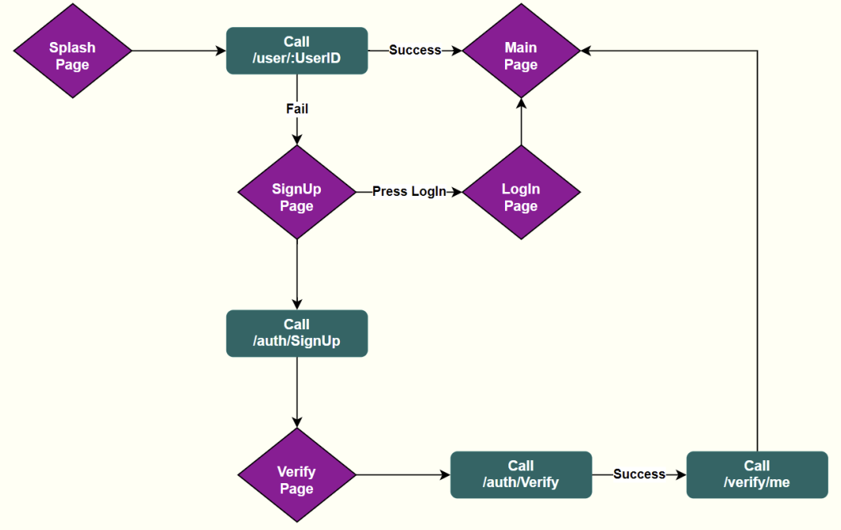
Page Transition Flowchart

Slide 7
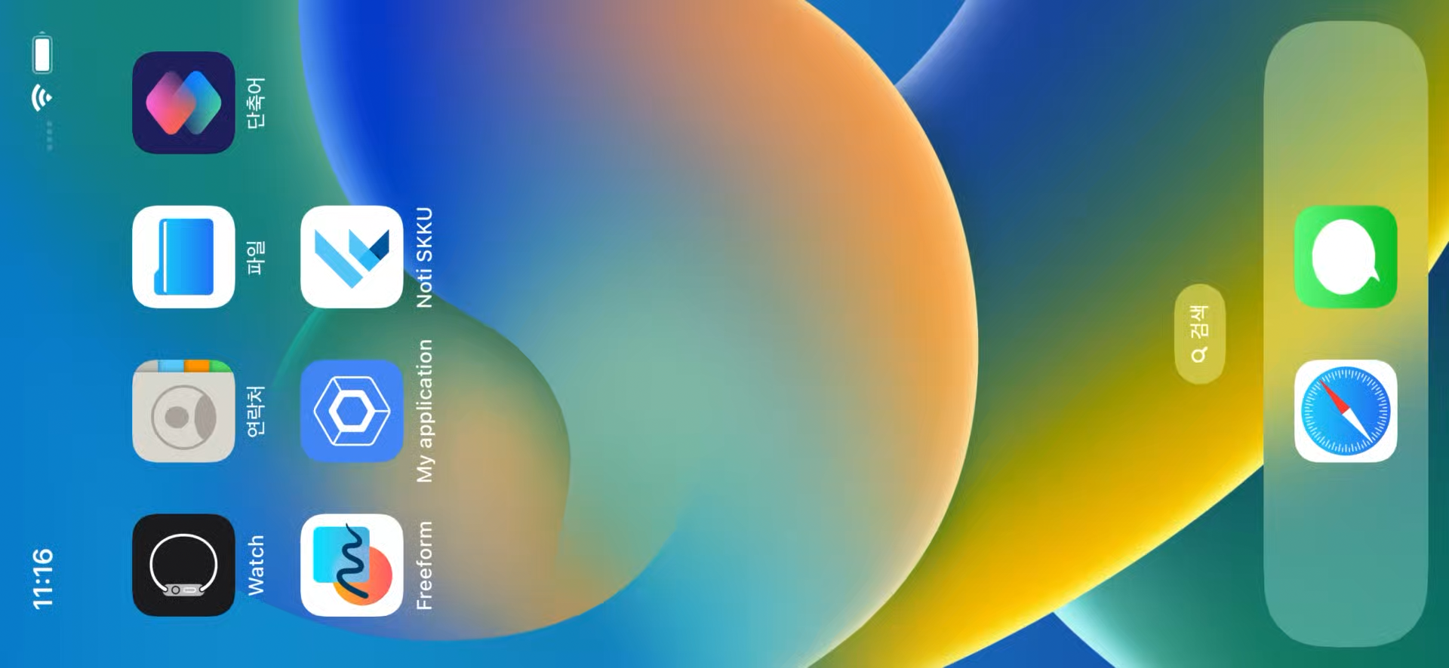
Sign Up

Slide 8

Sign In & Check notice

Slide 9
NEXT WEEK

Slide 10
Next Week
- Push alarms
- Subscribe
- Complete report

